Slide 1
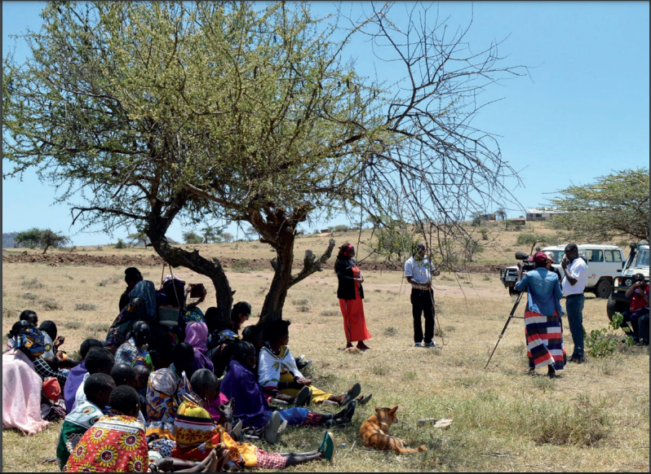
Training for gender and socially inclusive climate projects and programmes
An introduction to the modules

Slide 2
About the training pack
This resource pack is developed in response to requests by many climate and development practitioners around the world for a ‘how to do it’ guide on integrating gender and other aspects of social inclusion into climate projects and programmes.
The different sections in the pack maybe used independently or in combination, based on participants’ interests and needs.
The material is all ‘creative commons’ and may be used freely, we just ask that you attribute it to CDKN or to the original source (where noted).
Interactive games are included in the training modules to keep the trainees engaged during the sessions.
Case studies and handouts are all available, alongside the slide presentations, to help participants learn and discuss together.

Slide 3
In the training pack
Module 1: International frameworks
Module 2: Why a gender approach is needed
Module 3: Assessing people’s climate risks and resilience
Module 4: Assess options for and plan gender-responsive, socially-inclusive climate solutions
Module 5: Commit equity-responsive budget
Module 6: Implement projects and programmes inclusively

Slide 4
For more information
For more information on how to use the pack or questions and suggestions about the content in it, please write to:
enquiries:@cdkn.org
In your subject line, write ‘Query: Gender training pack’

