Slide 1
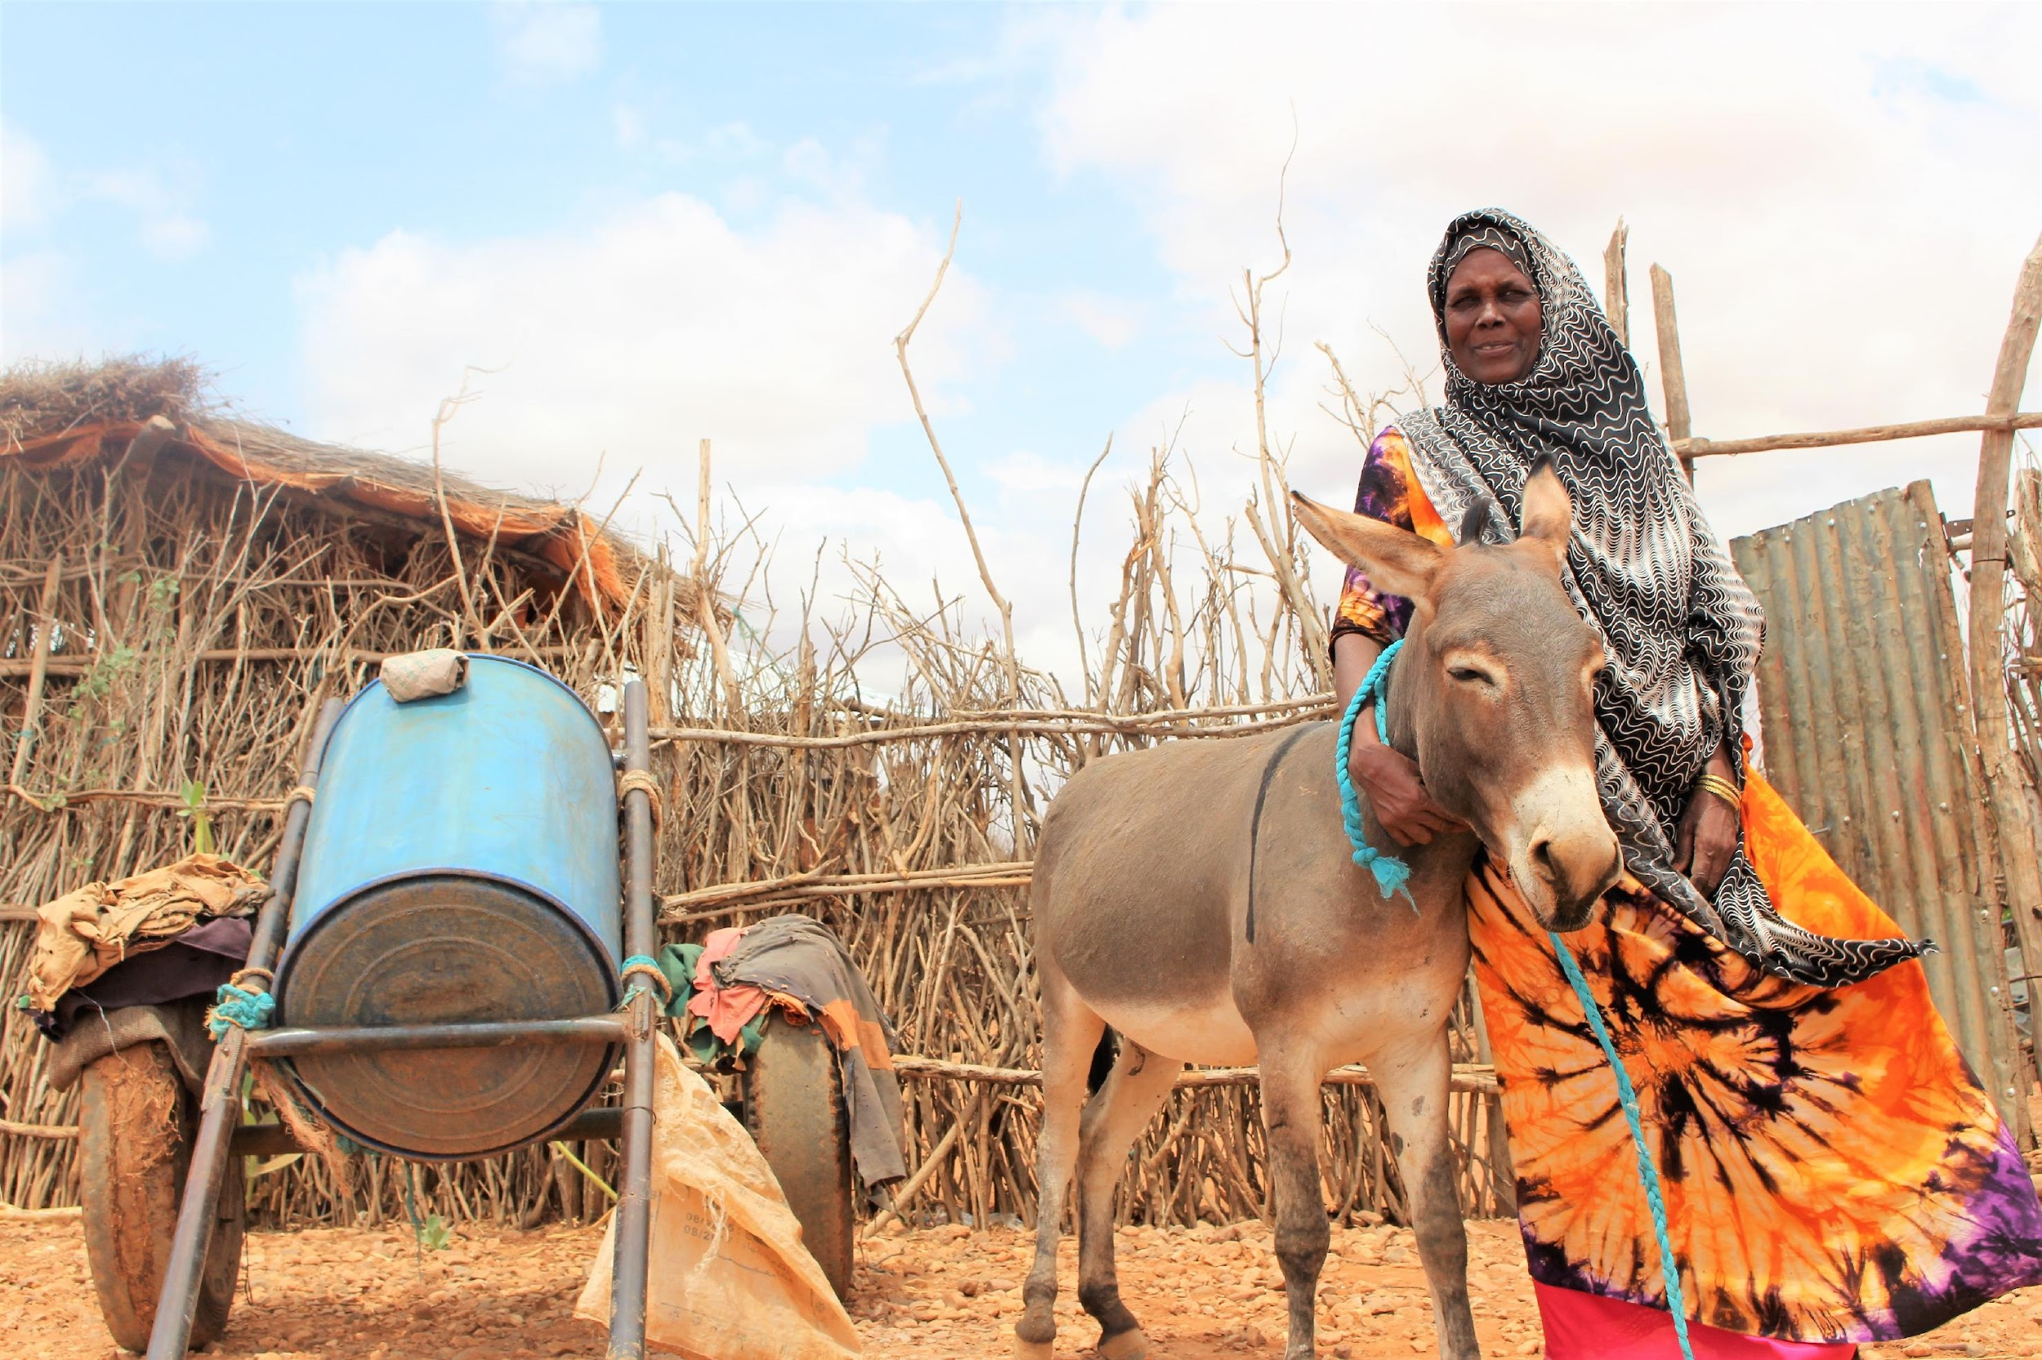
Gender and social inclusion: Taking practical measures to deliver work inclusively

Slide 2
In this module you will learn
Key operational measures that will ensure inclusivity of diverse people’s talents and needs once work is underway
Some operational guidelines for inclusion can be set and enforced in project or programme teams.
Some guidelines are owned by/set by institutions.
They include:
•Target- and indicator-driven operational measures (quantitative)
•‘Work culture’ issues (qualitative)
•Policies and mechanisms for addressing discrimination, grievance on the job or in the course of project work
Notes:
This module discusses measures that can be taken while work is underway to implement activities inclusively.
The focus is on operational measures and procedures.
Some of the operational guidelines discussed are appropriate for setting in a project context (including projects and programmes that are formed of multiple teams from many organisations and/or involve diverse community groups.
Some measures are a question of workplace ‘ethos’ and are more appropriately situated in a single organisation’s policy or code (e.g. workplace code of a government agency, or human resources policy of an organization, etc).
We have broadly split these into:
Target- and indicator-driven operational measures of a more quantitative variety. Although we have already covered these at the project planning stage of the course, we make some reminders here about how female-male participation and other aspects of diversity and inclusion can be continuously addressed during delivery of work.
Work and organisational culture issues of a more qualitative variety, about how people feel – their confidence in themselves – and how they feel and evidence that they are treated by others. This is about ‘setting the tone’ for gender and social inclusion. Although these issues are harder to count/measure per se, there are self-reporting methods by which people can monitor their own feelings of satisfaction and self-worth during their time working for an organisation or (in project context) before, during and after a project.
Policies and mechanisms for addressing discrimination and other forms of workplace or project grievance if they arise (whether at project/programme level or more appropriately hard-wired into institutional policy).

Slide 3
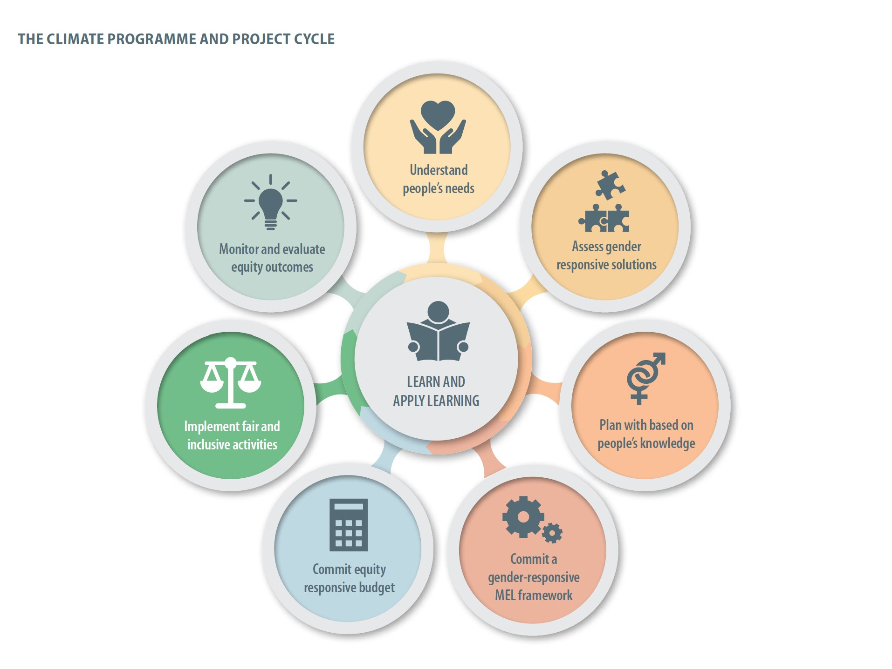
Notes:
•We are here on the project cycle but as mentioned, we will also discuss some measures and procedures that can also be undertaken at an organisation-wide level as part of wider work culture.

Slide 4
Targets and indicators (quantitative)
Numeric targets for women’s participation should be established from the outset of a project/programme. These can still be adjusted and adapted during implementation, where needed:
Establish minimum quotas for the participation of women in activities / trainings / speaking engagements / etc.
Ensure management arrangements promote gender balance and equality (e.g. composition of project management team, implementing partners, and steering committee)
Alongside these:
Encourage women to apply for formal job positions and leadership roles, where they are under-represented
Notes:
Facilitator/trainer: This would be a good place to open up the discussion to participants in short, to tailor this discussion to their circumstances.
-What are the governance and oversight arrangements for their organisation or their project? e.g. ask them: do you have a steering committee? A board of directors? What percentage are women? Should there be more women? What do you think is holding them back? How could representation be more equal?
-
-About minimum quotas for women in project activities and goals for gender balance in managerial and decision-making posititions, sometimes it is not enough to have passive targets. Sometimes more effort is required to find out why women do not apply to get involved – a more proactive strategy for understanding barriers to women’s participation. Do structural aspects need to be addressed such as childcare arrangements or facilities such as sanitary arrangements? Or, is it a matter of under confidence or feeling less skilled or valued, in which case, some targeted coaching/mentoring may be required for women?
-What forms of under-representation exist for other groups in project activities or organisational structures and what could be done to address the barriers to participation? E.g. for people with disabilities?

Slide 5
Work and organisational cultural issues (qualitative)
The working culture or ethos of a project is vital.
The commitment of the project to ‘dignity for all’ and ‘equality for and empowerment of women and girls’ cannot just be on paper but should be infused in everyday working practices.
Notes:
The working culture or ethos of a project is vital. It establishes the broader social environment in which project team members, partners and participants interact.
The commitment of the project to ‘dignity for all’ and ‘equality for and empowerment of women and girls’ cannot just be on paper but should be infused in everyday working practices. ●This commitment should be on a par with the project’s climate objectives. It is just as important.

Slide 6
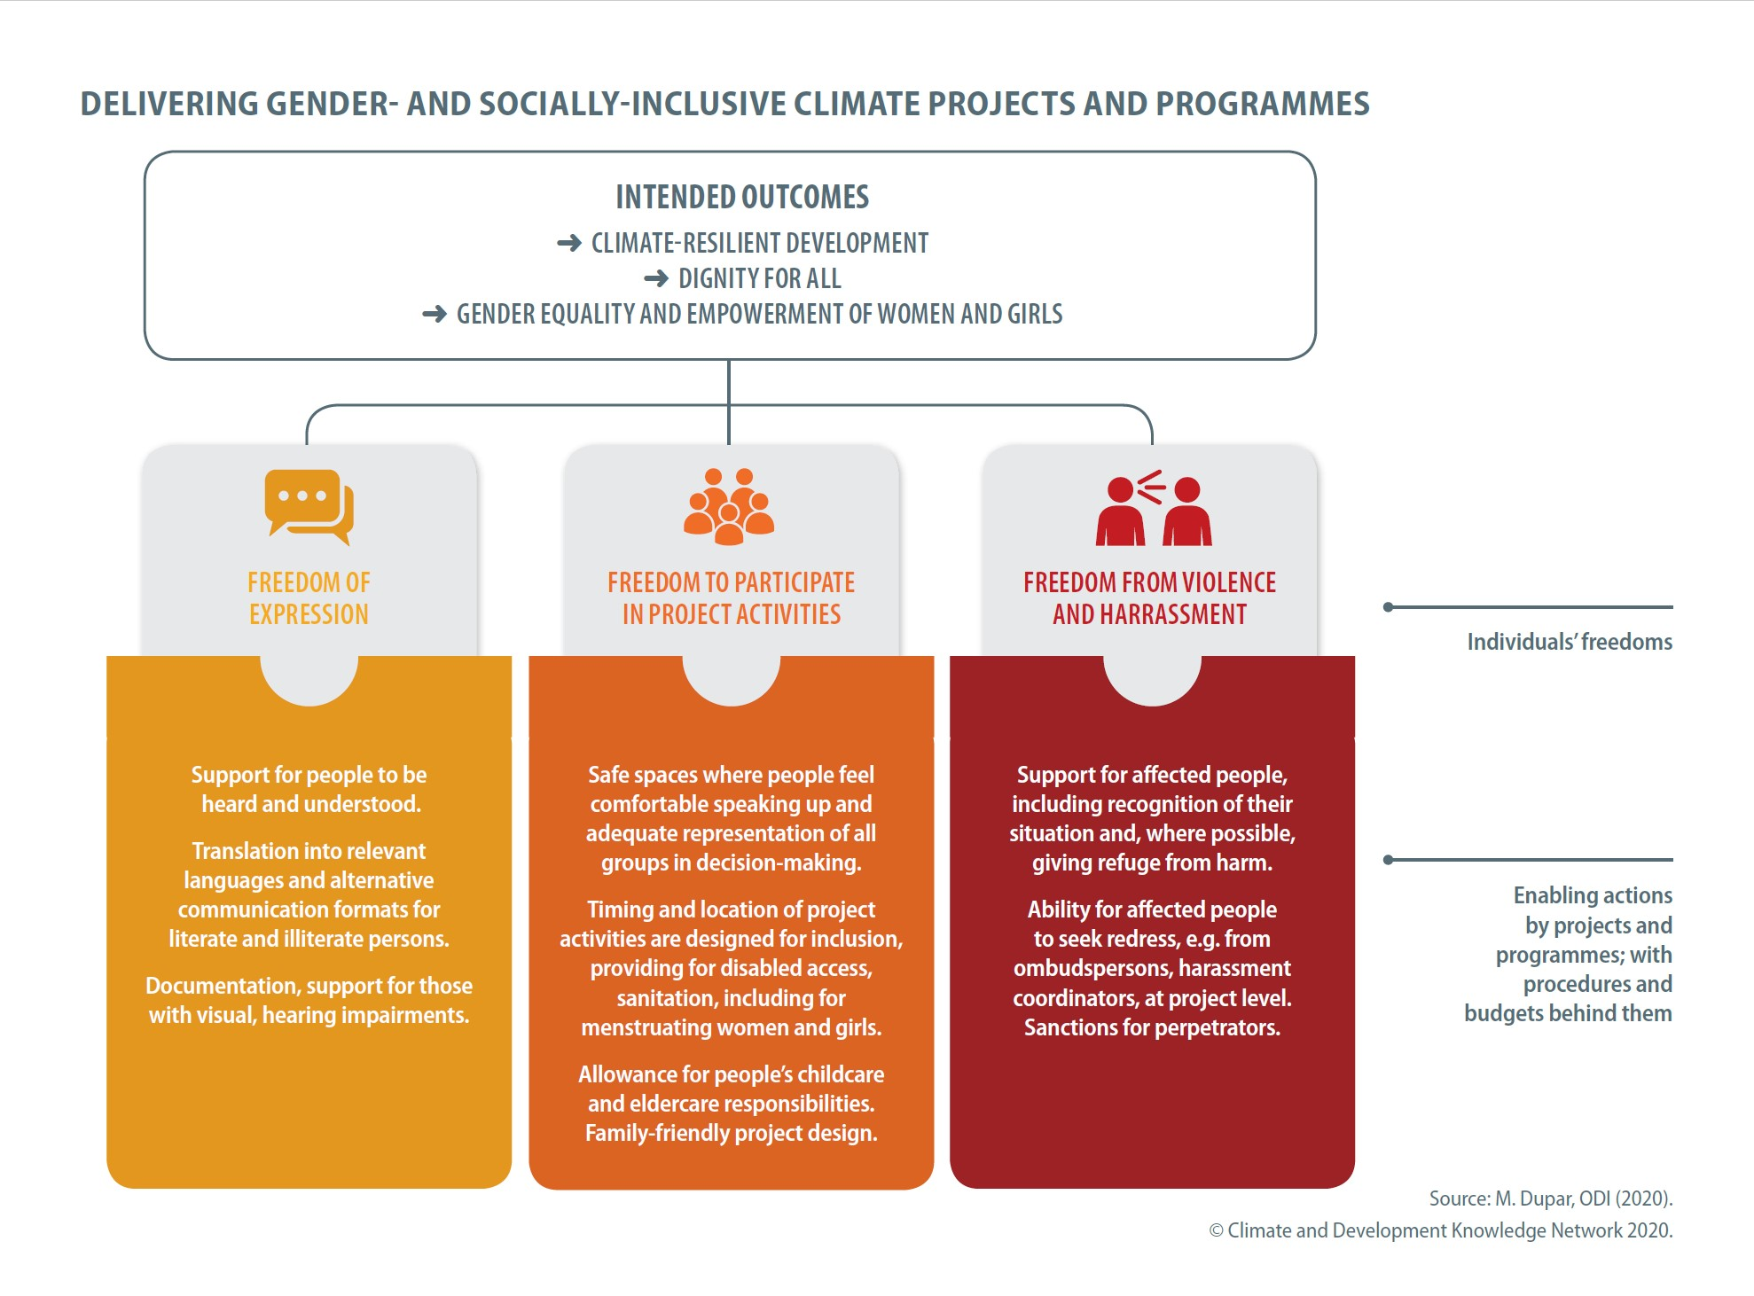
Notes:
●As a guide to creating a gender- and socially-inclusive project by establishing an inclusive work ethos and culture, we have produced this at-a-glance guide.
●It is based around the notion of freedoms for individuals (based on their rights and principles of fairness and equality) and the underpinning or enabling actions and procedures by projects and programmes to realise those rights and freedoms in the project context.
Facilitator:
●Run briefly through each of the areas given in the slide and the types of enabling actions, with procedures and budgets behind them, that would support these freedoms and rights. Answer any clarifying questions.
Expanded remarks include:
On ‘Freedom of expression’
●Communicate knowledge, advertise opportunities in places where women and other disadvantaged groups are likely to see / hear it.
●Use formats and channels that are inclusive
●Examples: if literacy is lower for women, use spoken word (megaphone; Tv; radio; reliable spoken word networks)
●Be aware of lower access to, control of IT by women in many areas (eg can’t access mobile phone, TV)
On ‘Freedom to participate in project activities’ – the CDKN Essential publication on women-friendly timing, organisation of the climate smart agriculture project in Nepal is an excellent example of how this action yields better project outcomes.
On ‘Freedom from violence and harassment’ – see next slide for expanded remarks.
●Then, assign the graphic for group discussion (below), after which, reconvene to discuss as a whole group. It may be necessary to go to the next slide for a longer exposition on freedom from violence and harassment before reverting to the discussion exercise.
●Suggested discussion exercise in pairs or small groups:
Discuss each area or ‘pillar’ (the yellow, orange, red pillars) in turn. Answer the associated questions.
Freedom of expression may require ‘support for people to be heard and understood.’
The diagram suggests, for example: Translation into relevant languages and alternative communication formats for literate and illiterate persons. Documentation, support for those with visual, hearing impairments.
-Discussion questions: Do you agree these actions would be helpful to support people to be heard and understood? Is anything missing to support diverse people to be heard, in a climate project/programme context? If so, what further actions do you suggest? Write these down to report back to the large group at the end.
Freedom to participate in project activities may require ‘Safe spaces where people feel comfortable speaking up’ and also ‘timing and location of project activities to be designed for inclusion’. Some examples given are disabled access, adequate sanitation provision, and allowance for childcare and eldercare responsibilities.
- Discussion questions: Do you agree these actions would be helpful? Is anything missing to support diverse people to participate actively, in a climate project/programme context? If so, what further actions do you suggest? Write these down to report back to the large group at the end.
Freedom from violence and harassment in project activities may require ‘support for those affected, including recognition of their situation, safety, refuge from harm (where possible). Some examples given are ombudspersons, harassment coordinators, etc.
- Discussion questions: Do you agree these actions would be helpful? Is anything missing to support diverse people to be free from violence or (intimidation, bullying) harassment in a climate project/programme context? If so, what? Write down your suggestions to report back to the large group at the end. For this last pillar and in view of the seriousness of violence against women and intimate partner violence, it can be beyond a climate project’s scope to deal categorically with instances which may fall under the purview of the police or state- or community-sponsored special services for victims of violence. What should be a project’s responsibility for recognising when people are suffering, and referring them or signposting them to special services?

Slide 7
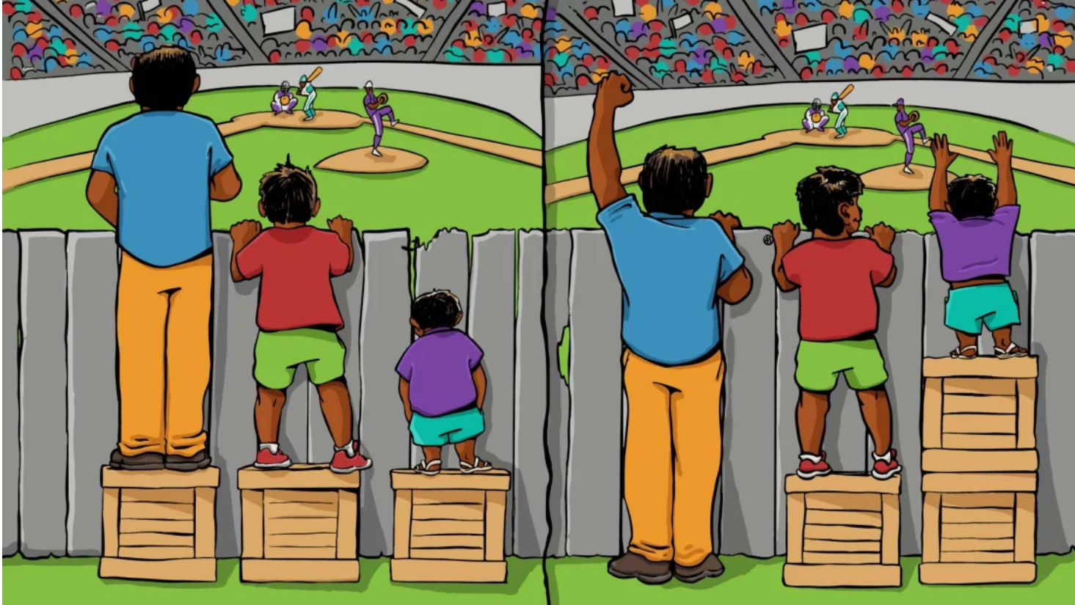
Freedom of expression, freedom to participate need some work to get it right!
Notes:
Facilitator: Remind participants of previous modules in the course where we discussed this concept – the left of the diagram is a depiction of ‘equality’ and the right is a depiction of ‘equity’ – sometimes it is necessary to change systems and processes in order to support everybody to have the same benefit! ‘Equal opportunity’ only (like on the left) may not be enough to let everyone have the benefit of freedom of expression, freedom to participate.
An example, in terms of operationalising climate projects may be: freedom of expression and freedom to participate may need special support for people who are visually or hearing impaired, for instance.

Slide 8
What does support for people affected by harassment and violence mean, in project context?
‘Anti-harassment policy’ can help support participation in project activities by everyone, regardless of gender, gender identity, age, religion, appearance, sexual orientation, origin and health, physical limitations etc.
‘Grievance redress mechanism e.g. by nominating 2-3 people in the group who are independent, trusted and can act as safe, confidential listeners to those who are affected, respectful of the need for anonymity. Participants who feel bullied, harassed or violated can access ombudspeople to share their concerns for investigation.
Based on discreet investigation, managers can reserve the right to exclude people from activities as a sanction, if they are found to be abusing or harassing others. Actual crimes should be referred to relevant authorities.
Notes:
More formal policies and mechanisms are also recommended for dealing with harassment or grievance on the grounds of sex, race, ethnicity, disability of other relevant characteristics (could even simply be an anti bullying policy to ensure dignity in the workplace), as described in this slide.

Slide 9
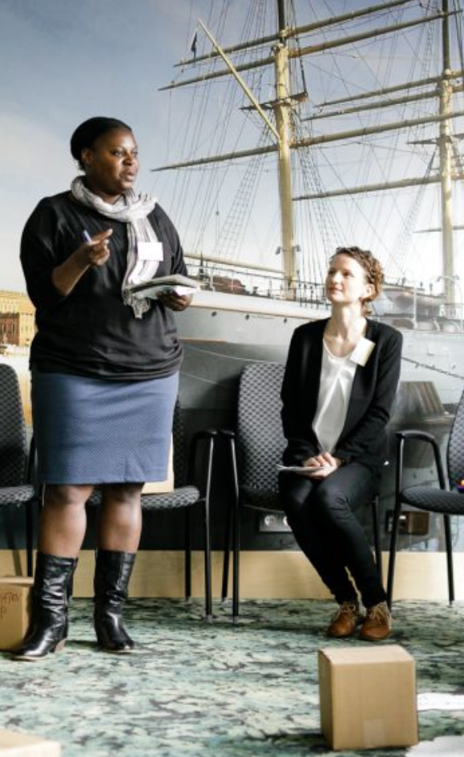
Case study: How we made the Global NDC Conference 2019 more gender-inclusive: 1 https://globalndcconference.org/
The focus of the conference was enhancing ambition in NDCs.
Standalone gender sessions were organised.
Gender was also a cross-cutting issue.
The organisers (including CDKN) established a comprehensive gender policy.
This included:
anti-harassment policy and mechanism
support for mothers
people designated to be ‘Gender Voices’
facilitator briefing

Slide 10
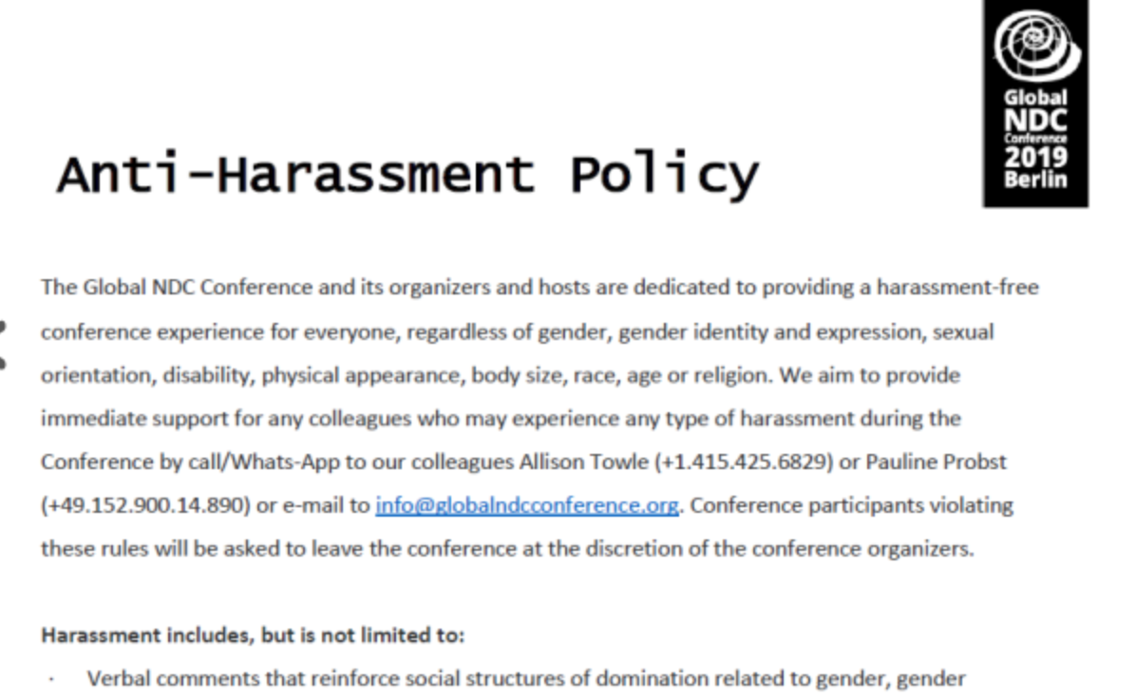
Case study: How we made the Global NDC Conference 2019 more gender-inclusive: 2 [Search https://globalndcconference.org/ ‘anti harassment policy’]
Anti-harassment policy and redress mechanism: designated contact points if you experience it (names, whatsapp, email)
Definition of what constitutes harassment
Sanctions for perpetrators
Notes:
Anti-Harassment-Policy_NDC-Conference-2019.pdf (globalndcconference.org)
https://globalndcconference.org/giz/wp-content/uploads/2019/06/Anti-Harassment-Policy_NDC-Conference-2019.pdf
Anti-Harassment Policy The Global NDC Conference and its organizers and hosts are dedicated to providing a harassment-free conference experience for everyone, regardless of gender, gender identity and expression, sexual orientation, disability, physical appearance, body size, race, age or religion. We aim to provide immediate support for any colleagues who may experience any type of harassment during the Conference by call/Whats-App to our colleagues Allison Towle (+1.415.425.6829) or Pauline Probst (+49.152.900.14.890) or e-mail to info@globalndcconference.org. Conference participants violating these rules will be asked to leave the conference at the discretion of the conference organizers. Harassment includes, but is not limited to: · Verbal comments that reinforce social structures of domination related to gender, gender identity and expression, sexual orientation, disability, physical appearance, body size, race, age, or religion · Inappropriate physical contact · Unwelcome sexual attention · Deliberate intimidation, stalking, or following · Harassing photography or recording · Sustained disruption of talks or other events · Sexual images in public spaces · Advocating for, or encouraging, any of the above behaviour
Reporting · If someone makes you or anyone else feel unsafe or unwelcome, please report it as soon as possible by calling or messaging our colleagues Allison Towle (+1.415.425.6829) or Pauline Probst (+49.152.900.14.890) or sending an email to info@globalndcconference.org. Harassment and other code of conduct violations reduce the value of our event for everyone. We want you to be happy at our event. People like you make our event a better place. · You can make a report either personally or anonymously. We can't follow up an anonymous report with you directly, but we will fully investigate it and take whatever action is necessary to prevent a recurrence. · Our team will be happy to help you contact hotel/venue security, local law enforcement, local support services, provide escorts, or otherwise assist you to feel safe for the duration of the event. We value your attendance.
Email address for organisers: info@globalndcconference.org Allison Towle (UNDP): +1.415.425.6829 Pauline Probst (GIZ): +49.152.900.14.890 Scandic Reception: +49.30.700.7790 Police: 112 Local sexual assault hot line: +49.800.011.6016 (https://www.hilfetelefon.de/en.html) Local taxi company: +49.30.20.20.20
Enforcement Participants asked to stop any harassing behaviour are expected to comply immediately. If a participant engages in harassing behaviour, event organisers retain the right to take any actions to keep the event a welcoming environment for all participants. This includes warning the offender or expulsion from the conference. Event organisers may take action to redress anything designed to, or with the clear impact of, disrupting the event or making the environment hostile for any participants. We expect participants to follow these rules at all event venue and event-related social activities. We think people should follow these rules outside event activities too

Slide 11
Case study: How we made the Global NDC Conference 2019 more gender-inclusive: 3 https://globalndcconference.org/
Support for mothers
At registration: asked whether having a nursing infant at home was a hurdle to traveling and participating in the conference
Offered to pay for/provide support for infant to travel as ‘lap child’ on aeroplane
Offered to provide childcare on site and a private, quiet nursing room
Nobody took up our offer but it was nice to make it available!

Slide 12
Case study: How we made the Global NDC Conference 2019 more gender-inclusive: 4 https://globalndcconference.org/
People designated to be ‘Gender Voices’ in every session
These volunteers received a briefing doc and in-person briefing before Session facilitators told they must empower women and all people to speak

Slide 13
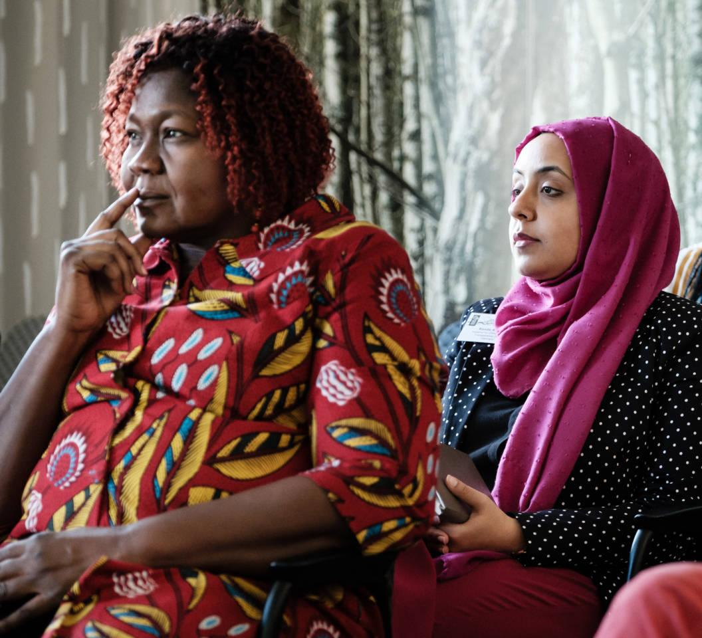
Why these things matter and why it’s important to get them right
Climate solutions are stronger and more successful when they empower women to be leaders. This may involve ‘unconventional’ forms of leadership.
Sometimes, the key to unlocking women’s knowledge, talents and skills co-depends on speeding up policy implementation in other areas e.g. enforcing laws on gender-based violence, land ownership
Notes:
CDKN has documented the following headline conclusions from the Global NDC Conference 2019
– Sometimes, the key to unlocking women’s knowledge, talents and skills co-depends on new policies or speeded-up implementation of existing policies in other areas of law. Enforcing laws against gender-based violence is just one example of a complementary action that frees women to have decent lives and so step up as equal partners to pursue climate progress.
– Climate solutions are more successful when they empower women to be leaders. This doesn’t necessarily mean ‘conventional’ and hierarachical forms of leadership; in fact, forms of reflective and collaborative leadership often shown by women are particularly well suited to addressing the complex climate crisis.
Facilitator’s note:
If it is relevant to the group of trainees, it may also be useful to explore the utility of designating ‘Gender Voices’ in conference and event settings: people with designated roles to raise issues from a gender perspective – so that gender discussions don’t get sidelined but are consistently mainstreamed. Follow the links below for more information about ‘Gender Voices’.
For detail, see dedicated blog on gender issues by CDKN: https://globalndcconference.org/a-real-accelerator-for-achieving-climate-goals/ and Conference key messages document: https://globalndcconference.org/giz/wp-content/uploads/2019/06/190617-GNDC2019-Key-messages.pdf

Slide 14
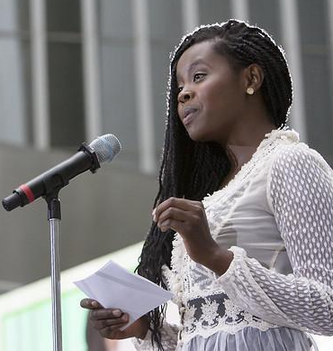
Skills are needed to drive social inclusion and women’s and girls’ empowerment
Capacity building may be needed for project/programme staff to deliver this safe and supportive working environment: to have sufficient gender and social awareness and practical tools to use.
Also capacity building of women and girls may be needed to make them aware of their rights, and to build their confidence.
Notes:
Skill building in GESI skills, of climate professionals
Skill-building on the climate project/programme team is normally needed to drive women’s inclusion and empowerment in climate projects and programmes/
This general awareness and sensitisation is needed in addition to appointing a gender and social inclusion focal person(s) to drive forward the agenda consistently and continuously in the project/programme.
Capacity building, confidence building of women and girls themselves as a standalone activity or in the way the individual elements of the climate project/programme is designed
Capacity building of women and girls may be needed to make them aware of their rights, and to build their confidence to step up and participate equally and fully in project activities, to take advantage of the opportunities offered in decision making and leadership as well as merely as ‘beneficiaries’.

Slide 15
If you don’t get things right at first, you can still adapt and improve along the way
Key lesson learned from CDKN research in India, Peru and Kenya:
Optimal to plan for gender- and socially-inclusive delivery from beginning but don’t give up if it’s hard to achieve. Adaptive management along the way is possible. E.g. Take new initiatives to involve women in leadership positions.
10 Things to Know: Gender Equality and Achieving Climate Goals (CDKN, 2016) https://cdkn.org/gender-equality-climate-compatible-development
Notes:
In CDKN’s ‘10 Things to know about gender equality and achieving climate goals’ report, we talk about the Gorakhpur, India example of the ACCRN project whereby the explicit outcomes were not defined in a gender-responsive way at first but the team still developed these part-way through the project when they realised that inadequate participation by and benefit to women was jeopardising achievement of the project’s goals. [This is under the heading in our report: “No 7 When projects don’t use a gender approach, participatory processes can still ‘save the day’.“]

Slide 16
Notes:
GESI (gender and social inclusion) bingo game
Facilitator/trainer instructions
Please look through the play cards (see separate sheet with the game play cards). Each card describes different ‘measures we can take to deliver climate projects and programmes that are inclusive for everybody’.
The intention is to cut out these rectangles – each one individually – as little cards for the ‘GESI bingo’ game. Please review the content of the suggested cards very carefully.
Before you distribute the cards, please remove any cards whose content is contextually irrelevant or inappropriate for your group of trainees.
For example, if your trainees are going to be implementing climate projects or programmes in rural villages where parents always carry infants in a sling on their front or back, and do not use pushchairs/prams, then please remove the card that says ‘make meetings pushchair-friendly’ from the set, as it would be irrelevant to the participants’ context.
But only remove cards if it’s completely irrelevant for the project implementation context – you want some of the measures to be ‘stretching’ for the participants and to touch on measures that could be relevant in the delivery of their climate projects and programmes, but they didn’t think about yet.
If you have a very mixed group of participants, e.g. from a range of different countries or urban/rural locations, or very different job responsibilities, then err on the side of including all cards or as many as possible and don’t be too selective.
Furthermore, the cards are provided as a Word document so that the facilitator/trainer can translate or edit the words for appropriateness where needed.
Please note that the cards are focusing on measures that a project manager for a climate project/programme would have the authority to take, and which are largely voluntary or discretionary in a project context. The actions don’t focus on enforcement of employment law in a formal employment setting – e.g. as when a company or organisation is legally required to provide its workers with maternity and paternity leave, sick leave and benefits, etc.
A full set of appropriate cards needs to be printed one-sided on paper or card for every pair of trainees – they should ideally be playing this game in pairs or possibly, in threes.
The game play instructions
Version 1 (slower version, players stay seated):
Players organise themselves into pairs or groups of three.
Position one set of cards, face down in a pile, between the players (in their groups of two or three).
Each player should have an answer sheet, and have a pen ready to write their answers explaining which three actions they will take and how they will do it (what are the circumstances in which they could take this action).
Players take it in turns to pull a card from the central pile, one at a time.
Turn over the top card on the pile, and read out the action described. The action is for them, the player who drew the card, and they must answer from their perspective, speaking aloud to the rest of their pair/group.
Answer the question: is this an action/a measure I am already taking in my climate project, programme or organisation? OR is this an action/a measure that my organisation and I could take?
If it’s a ‘yes’, then keep the card, and write briefly on the answer sheet what the action is, and how you are applying the action in your project/team or how you could apply the action in your project/team – ie, what are the contexts or circumstances. For example, if you draw the card ‘in key decision-making processes, ensure that women are as well represented as men’ and if you are running a committee to advise your climate project on key aspects, you could say: ‘we don’t currently have good gender balance on our project advisory committee but this is something that we could address by recruiting more women in the near future’.
If it’s a ‘no’, you are not applying this action in your project/team, and you cannot think of any way to apply the action usefully or feasibly in your project/team, then put the card back, face down, at the bottom of the central pile. Skip your turn, the turn goes to the other person. Do not fill in the answer sheet this time.
As soon as one of the pair, or one of the players in the group, accumulates three cards, representing measures they are already taking or could take, then they shout ‘bingo!’ and draw the game to a close for the entire room.
(Tip: if this happens too fast, and doesn’t give enough time for discussion by each group or pair of players about the action cards they drew and the answers they gave, then, the facilitator can extend it to five cards before anyone can shout ‘bingo!’)
After the play comes to an end, the facilitator invites the person who shouted ‘bingo!’ to read out their three (or five) cards and the explanations they gave out their answer sheet for how they are applying these actions in their project/organisation, or how they could apply their actions.
Other participants are invited to volunteer their answers, if they wish.
The facilitator can also ask players to ‘fill in the gaps’ and mention measures to take in the delivery of climate projects and programmes, for greater inclusiveness, that were not listed on the cards but should have been.
Version 2 (faster version, with movement around the room):
The facilitator puts a big poster or draws on a whiteboard on the wall of the room a large picture of a tree with lots of branches or – if you feel less artistic – just write in large letters at the top of the sheet or board ‘Our commitments to be inclusive’.
Players organise themselves into pairs or groups of three.
Position one set of cards, face down in a pile, between the players (in their groups of two or three).
Each player takes three post-it notes to write down the three actions they are going to take (or five post-it notes, if the facilitator decides to extend the game to make it more complete).
Players take it in turns to pull a card from the central pile, one at a time.
Turn over the top card on the pile, and read out the action described.
Answer the question: is this an action/a measure I am already taking in my climate project, programme or organisation? OR is this an action/a measure that my organisation and I could take?
If it’s a ‘yes’, then keep the card, and write briefly [in short form] on a post-it note what the action is.
If it’s a ‘no’, you are not applying this action in your project/team, and you cannot think of any way to apply the action usefully or feasibly in your project/team, then put the card back, face down, at the bottom of the central pile. Skip your turn, the turn goes to the other person. Do not fill in a post-it note.
As soon as one of the players accumulates three cards, with three corresponding post-it notes, representing measures they are already taking or could take, then they run to the ‘Our commitments….’ sheet and post their post-it notes (representing inclusive actions) on to the sheet. See who gets there first!
(Tip: if this process happens too fast, and doesn’t give enough time for small group discussion, the facilitator can extend it to five cards/five post-its before anyone can have a complete set)
After the play comes to an end, the facilitator invites the person who was first to post their three (or five) commitments to inclusivity to explain to the other players what the actions are, how they are applying these actions in their project/organisation, or how they could make a commitment to apply their actions.
Other players can come up and post their post-its on the board/sheet, and everyone can stand around and see which actions the others are doing or feel committed to doing. The facilitator can also spot, and raise for discussion, those actions that people are not taking or committed to taking, and ask why. The facilitator can also ask players to ‘fill in the gaps’ and mention measures to take in the delivery of climate projects and programmes, for greater inclusiveness, that were not listed on the cards but should have been. Players can fill in new post-its and post them under a new category ‘further things we should think about to be inclusive in delivering climate projects and programmes’.

Slide 17
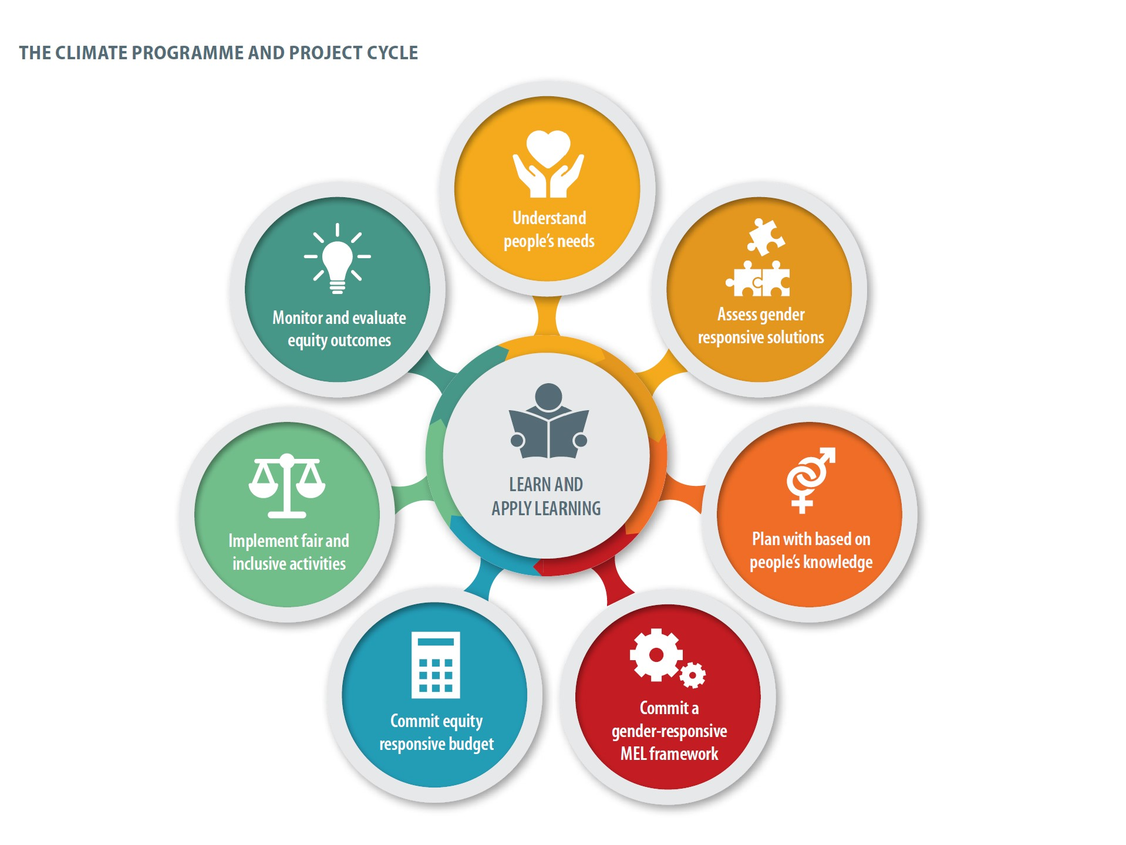
Notes:
That completes our review of how to integrate gender and social inclusion in the project and programme cycle, with tips also for broader inclusion in organizational culture.
The Monitoring and Evaluation process should reveal the outcomes in terms of social and gender equity. This should drive an internal learning and reflection process in the project or programme, which should not sit on a shelf but should be applied – it enhances mutual understanding of people’s needs and capabilities and the adaptive management of the current and future climate and development interventions.
‘We have to be honest with ourselves, and open, and learn fast in the face of the climate emergency’

Slide 18
www.cdkn.org
@cdknetwork
Notes:
Facilitator: insert your name and contact information here

