Slide 1

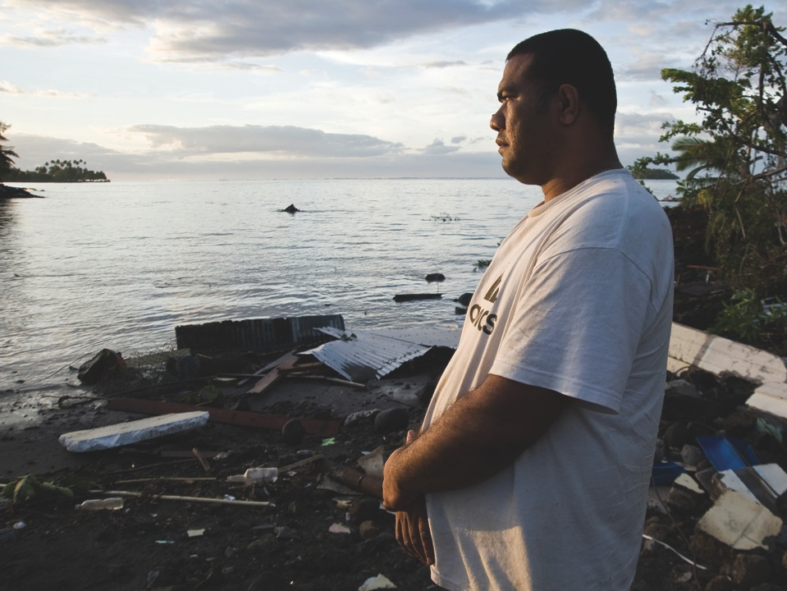
^{The}
^{IPCC’s Fifth Assessment Report}
What’s in it for
Small Islands
Developing States?
Key findings

Slide 2
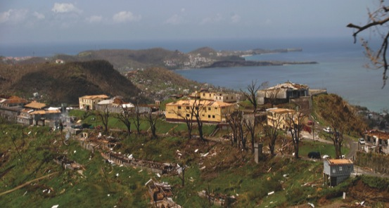
The climate is already changing
Since the 1950s, the rate of global warming
has been unprecedented compared to previous decades and millennia
The IPCC says with 95% certainty that increasing concentrations of greenhouse gases in the atmosphere due to human activities have been
the dominant cause of observed warming since
the mid-20th century

Slide 3
SIDS are already feeling the impacts
Even today, climate-related risks for SIDS include sea level rise, tropical and extra-tropical cyclones, increasing air and
sea surface temperatures, and changing rainfall patterns (high confidence)
BUT
In most small islands, long-term quality-controlled climate data are generally sparse

Slide 4
SIDS are already feeling the impacts

Slide 5
Further climate change is inevitable
^{What are the IPCC scenarios?}

Slide 6
Temperature, rainfall and sea level rise will change in Caribbean, Indian Ocean and Pacific Island regions

Slide 7
Impacts of global warming
Observed and projected global annual average temperature
Global risks under increasing levels of climate change

Slide 8
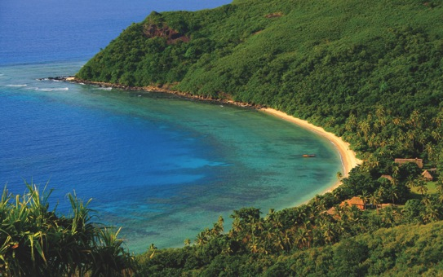
Climate change is affecting growth and development in SIDS
Tourism
Tourism is a weather- and climate-sensitive sector which is important for many SIDS
Resource degradation such as beach erosion and coral bleaching negatively impact the attractiveness of tourist destinations

Slide 9
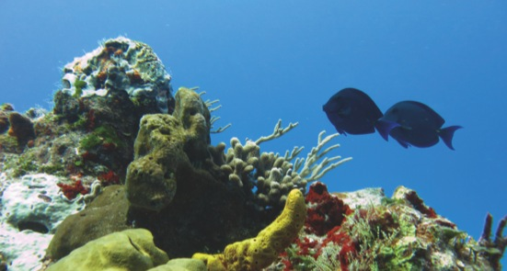
Climate change is affecting growth and development in SIDS
Marine ecosystems
“Marine ecosystems have been affected by climate change already (very high confidence)”-IPCC
Coral reefs, sea grass, mangroves provide ecosystem goods and services, e.g.
Fish breeding grounds
Coastal protection from storms

Slide 10
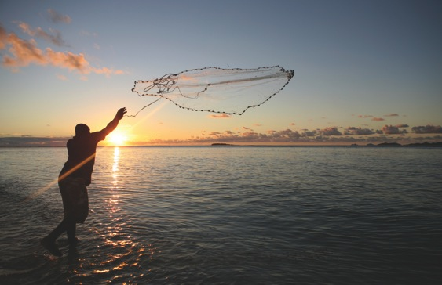
Climate change is affecting growth and development in SIDS
Freshwater availability
Saline intrusion into groundwater supplies
Terrestrial ecosystems
Shifts in species distribution

Slide 11
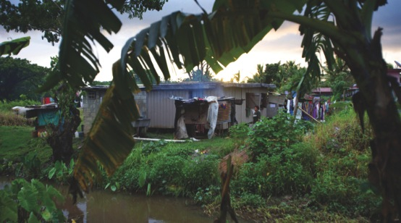
Climate change is affecting growth and development in SIDS
Infrastructure, settlement and ‘coastal squeeze’
Development on coasts, squeezed by rising
sea levels
Population drift and rapid population growth
Public health
Impacts of extreme weather on human lives, health
Incidence, spread of diseases

Slide 12
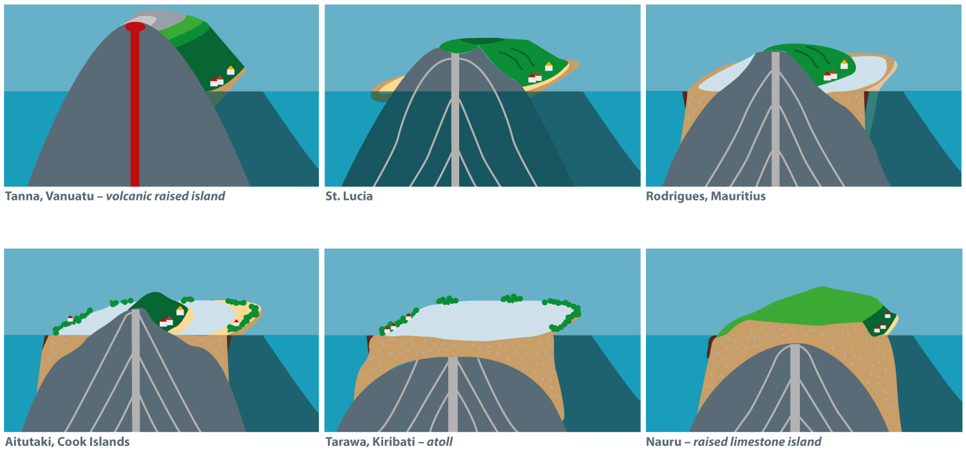
Climate-related risks vary for different island states
Climate change trends have varying impacts on small islands, dependent on the magnitude, frequency and extent of the event, as well as on the bio-physical nature of the island and its social, economic and political setting . Thus, small islands do not have uniform climate change risk profiles (high confidence)

Slide 13
Climate change poses an existential threat to some SIDS
Due to sea level rise projected throughout the 21st century and beyond, coastal systems and low lying areas will increasingly experience adverse impacts such as submergence, coastal flooding and coastal erosion (very high confidence)

Slide 14
Adaptation can reduce the impacts of climate change, but there are limits and risks involved
Carefully planned adaptation activities make for good development. ‘No regrets’ and ‘low regrets’ measures:
Increasing access to information
Improving health services
Diversifying cropping systems
Strengthening access to land, credit and other resources especially for poor and marginalised groups
Improving governance of water and land resources

Slide 15
Adaptation can reduce the impacts of climate change
Loss of livelihoods, coastal settlements, infrastructure, ecosystem services, and economic stability

Slide 16
Adaptation can reduce the impacts of climate change
The interaction of rising global mean sea level in the 21st century with high-water-level events will threaten low-lying coastal areas

Slide 17
The economic cost of adaptation to climate change is high in SIDS relative to the size of their economies
Damage costs for SIDS are enormous in relation to the size of their economies, they will find it most difficult to raise the necessary finances
E.g. unit cost of shoreline protection per capita in small islands is substantially higher than for a larger territory with a larger population
“In many cases, we are not prepared for the climate-related risks we already face. Investments in better preparation can pay dividends both in the present and for the future.”
– Vicente Barros, IPCC Working Group II Co-Chair

Slide 18
Promoting ambitious global action
In order to limit global warming to less than 2ºC, total emissions from human activity should not exceed 800–1000 gigatonnes of carbon dioxide equivalent, to date, human activity has release 500 gigatonnes
Pledges by world leaders are not enough to limit global warming below 2ºC

Slide 19
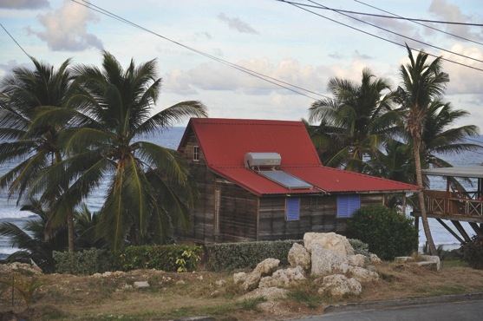
SIDS stand to benefit from integrated adaptation-mitigation-development approaches
Many sustainable development pathways combine climate adaptation, mitigation, development options effectively

Slide 20
Transformation to a low-carbon economy implies new investment patterns
Historic emissions from SIDS have contributed extremely little to global greenhouse gas concentrations
SIDS countries can nonetheless benefit from low-carbon investments because it confers other advantages, such as reducing dependence on costly imported fossil fuels (energy security)

Slide 21
International cooperation is vital to avert dangerous climate change
Every government must participate in global negotiations toward a collective solution
Developed countries have committed to mobilising $100 billion/year by 2020 for adaptation and mitigation in developing countries
“International cooperation is required to effectively mitigate greenhouse gas emissions and address other climate change issues…outcomes seen as equitable can lead to more effective cooperation”–IPCC

Slide 22
Download resources
including infographics and slides: www.cdkn.org/ar5-toolkit
Find the IPCC’s Fifth Assessment Report: http://www.ipcc.ch/report/ar5/
Contact: enquiries@cdkn.org

