Slide 1

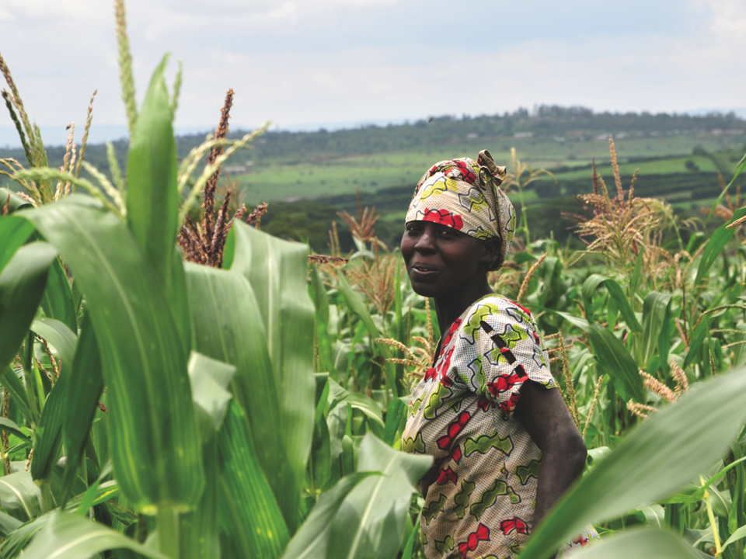
^{The}
^{IPCC’s Fifth Assessment Report}
^{What’s in it}
^{for Africa?}
Key findings

Slide 2
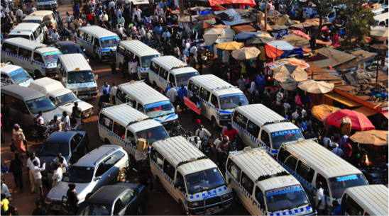
Africa’s climate is already changing
Since the 1950s, the rate of global warming has been unprecedented compared to previous decades and millennia.
The IPCC says with 95% certainty that increasing concentrations of greenhouse gases in the atmosphere due to human activities have been
the dominant cause of observed warming since the mid-20th century.

Slide 3
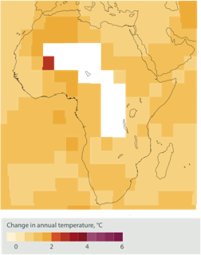
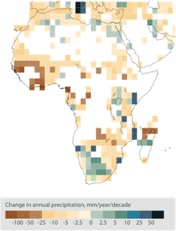
Africa’s climate is already changing
African surface temperatures have already increased by 0.5–2ºC over the past 100 years.
There is insufficient data on rainfall trends, where
it exists, it shows rainfall patterns are changing.
Change in annual average temperature in Africa,
^{1901–2012}
Change in annual average temperature in Africa,
^{1901–2012}

Slide 4
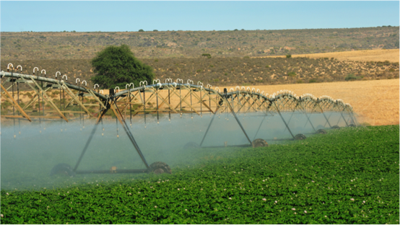
Climate impacts are already being felt
Incidence of malaria
Wheat production and productivity of other crops
Productivity of fisheries
Cycles of droughts and floods

Slide 5
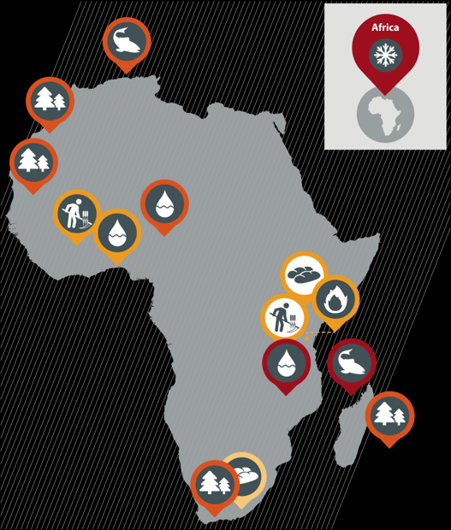
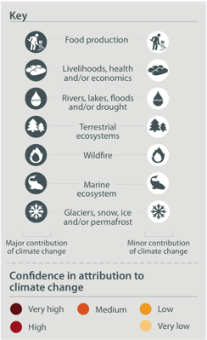
Observed impact of climate change in Africa

Slide 6
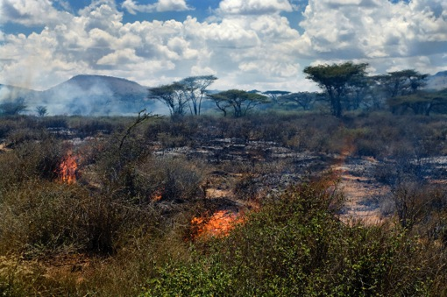
Further climate change is inevitable in the coming decades
Regardless of future emissions, we are already committed to a further warming world.
If the world continues to emit greenhouse gases at current rates, average global temperature could rise by 2.6–4.8ºC by 2100 (highest emissions scenario – business as usual).

Slide 7
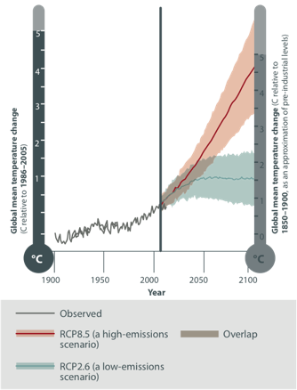
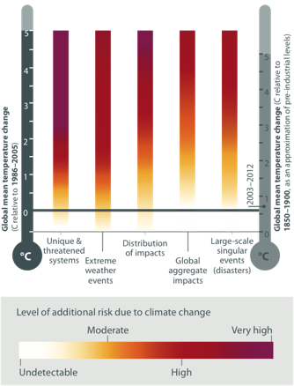
Future impacts of global warming
Observed and projected global annual average temperature
Global risks under increasing levels of climate change

Slide 8
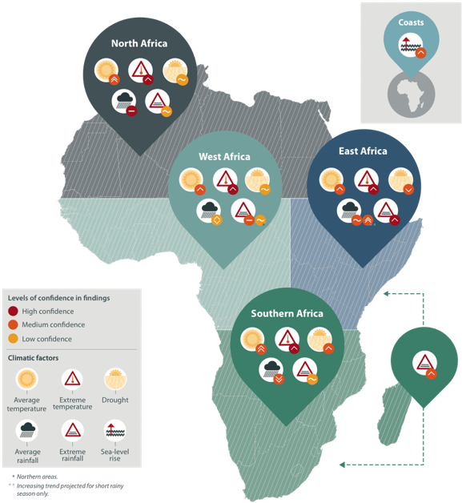
Future climate trends for Africa
– overview

Slide 9
North Africa future climate trends

Slide 10
East Africa future climate trends

Slide 11
South Africa future climate trends

Slide 12
West Africa future climate trends

Slide 13
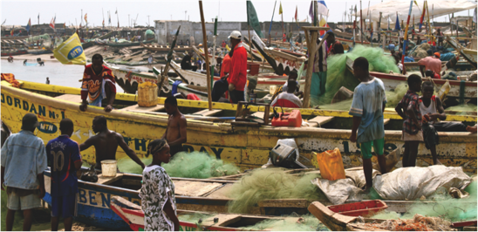
Climate change poses challenges to growth and development in Africa
Recent economic gains have been in climate-sensitive sectors, such as agriculture, fisheries.
Demographic trends will compound the adverse consequences of climate change.
Eg rapidly growing population will increase competition for freshwater and food, while prolonged drought and high temperatures will reduce crop yields and put pressure on scarce water resources.

Slide 14
Adaptation will bring immediate benefits and reduce the impacts of climate change in Africa
Carefully planned adaptation activities make for good development. ‘No regrets’ and ‘low regrets’ measures:
  Increasing access to information
  Improving health services
  Diversifying cropping systems
  Strengthening access to land, credit and other resources especially for poor and marginalised groups
  Improving governance of water and land resources

Slide 15
Adaptation can reduce the risks of climate change

Slide 16
Adaptation can reduce the risks of climate change
Add text to explain table here – row 2

Slide 17
Adaptation can reduce the risks of climate change
Add text to explain table here – row 3

Slide 18
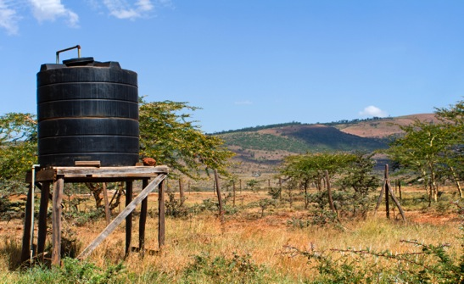
Adaptation is fundamentally about risk management
“In many cases, we are not prepared for the climate-related risks we already face. Investments in better preparation can pay dividends both in the present and for the future.”
– Vicente Barros, IPCC Working Group II Co-Chair

Slide 19
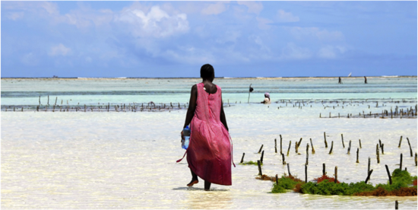
Adaptation experience in Africa is growing
Many African countries are working to integrate adaptation into development planning
Initiatives in African countries at national
government level:
  National Climate Change Response Strategies
  National Adaptation Plans of Action (in Least Developed Countries)

Slide 20
Promoting ambitious global action
In order to limit global warming to less than 2ºC, total emissions from human activity should not exceed 800–1000 gigatonnes of carbon dioxide equivalent, to date, human activity has release 500 gigatonnes
Pledges by world leaders are not enough to limit global warming below 2ºC
On the current trajectory, parts of Africa will experience 2ºC rise by mid-21st century
Climate mitigation must be a shared effort

Slide 21
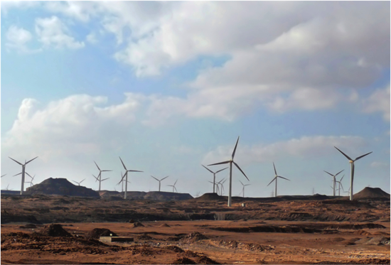
Some low-carbon development options may be less costly in the long run and could offer new economic opportunities for Africa
African countries can adopt clean, energy efficient technologies and side-step ‘lock in’ to fossil fuel dependent infrastructure
It is cheaper to invest in low-carbon options now than to lock in to conventional alternatives

Slide 22
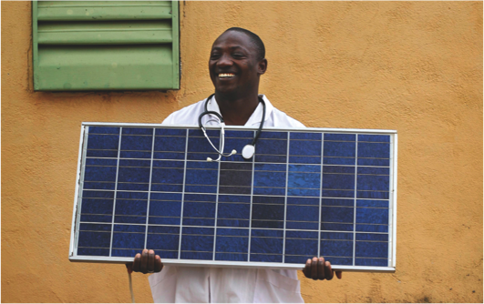
Africa stands to benefit from integrated climate adaptation, mitigation and development approaches
Many sustainable development pathways combine climate adaptation, mitigation, development options effectively
Decentralised, renewable power systems avoid greenhouse gas emissions, dependence on costly
and unreliable fossil fuels, more resilient to climate extremes and variability

Slide 23
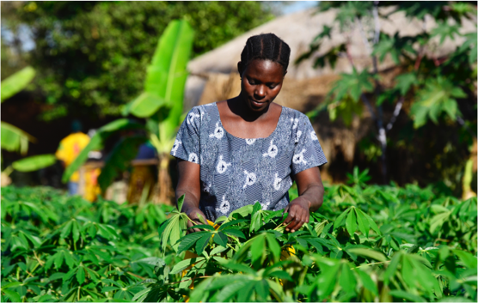
Africa stands to benefit from integrated approaches
Many sustainable development pathways combine climate adaptation, mitigation, development options effectively
Agroforestry schemes can allow farmers to generate income and accumulate assets from carbon capture, wood-based energy and improved soil fertility, and can promote resilience through species diversity

Slide 24
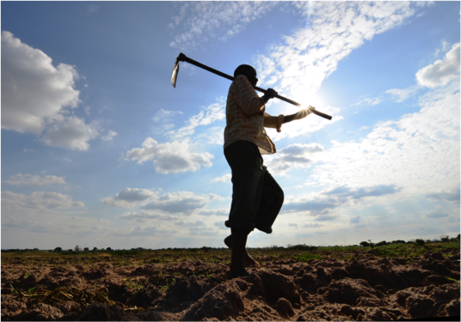
International cooperation is vital to avert dangerous climate change and African governments can promote ambitious global action
Every government must participate in global negotiations toward a collective solution
Developed countries have committed to mobilising $100 billion/year by 2020 for adaptation and mitigation in developing countries

Slide 25
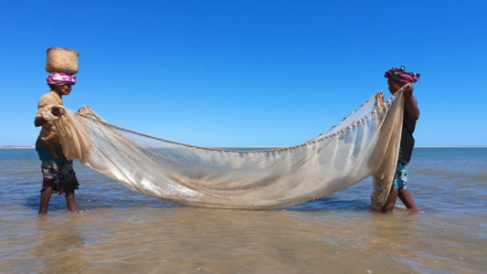
“International cooperation is required
to effectively mitigate greenhouse gas emissions and address other climate change issues … outcomes seen as equitable can lead to more effective cooperation”
–IPCC

Slide 26
Download resources
including infographics and slides: www.cdkn.org/ar5-toolkit
Find the IPCC’s Fifth Assessment Report: http://www.ipcc.ch/report/ar5/
Contact: cdkn@southsouthnorth.org

